Slide 1
Python Programming
Course Code: INT 213

Slide 2

Programming ..??
Notes:
So ,Guys how many of you are afraid of programming ???? , who think that coding is the most difficult thing to do ??? Pick one of them and ask him/her the recipe of Maggi or tea …

Slide 3
Algorithms v/s programming
Algorithm: how to systematically perform a task
Write down as a sequence of steps
“Recipe”, or program
Programming language : describes the steps
What is a step? Degrees of detail
“Arrange the chairs” vs “Make 8 rows with 10
chairs in each row”

Slide 4
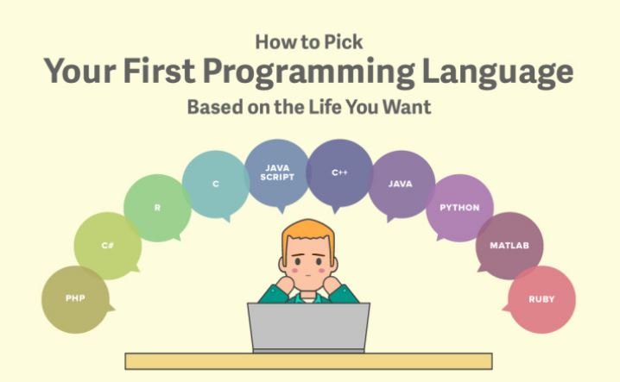
Which Programming Language ??

Slide 5
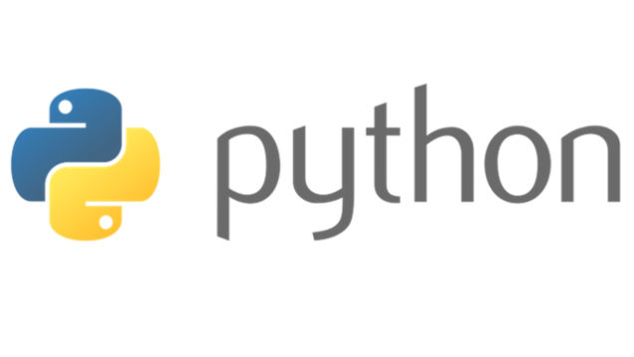

Slide 6
What is Python?
Python is an open source, object-oriented, high-level powerful programming language.
Developed by Guido van Rossum in the early 1989. “Monty Python's Flying Circus”, a BBC comedy series from the 1970s.
Python runs on many Unix variants, on the Mac, and on Windows 2000 and later.

Slide 7
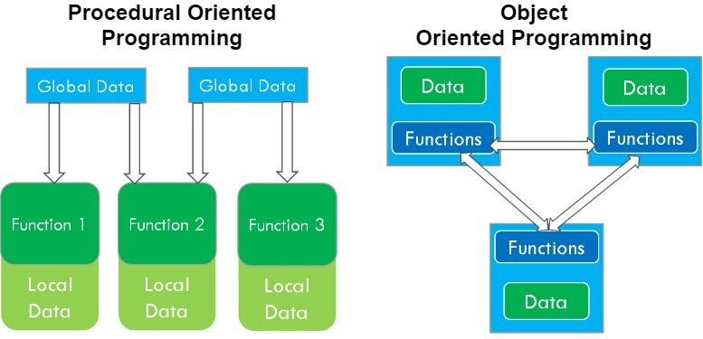

Slide 8


Slide 9
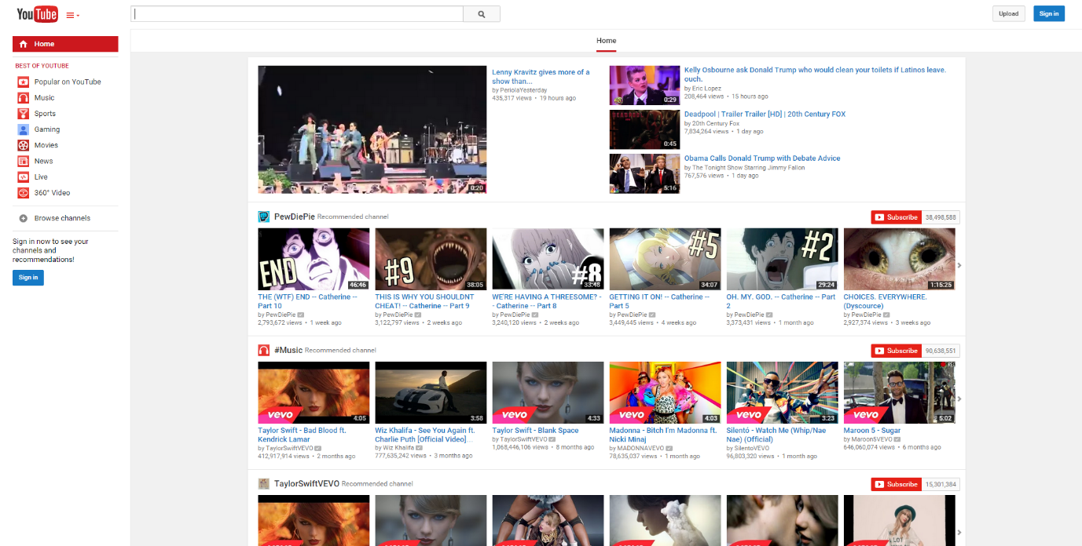
YOUTUBE
Notes:
We all know YouTube as the place to upload cat videos and fails. As one of the most popular websites in existence, it provides us with endless hours of video entertainment. The Python programming language powers it and the features we love.

Slide 10
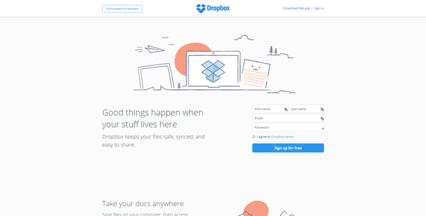
DROP BOX
Notes:
DropBox started the online document storing revolution that has become part of daily life. We now store almost everything in the cloud. Dropbox allows us to store, sync, and share almost anything using the power of Python.

Slide 11
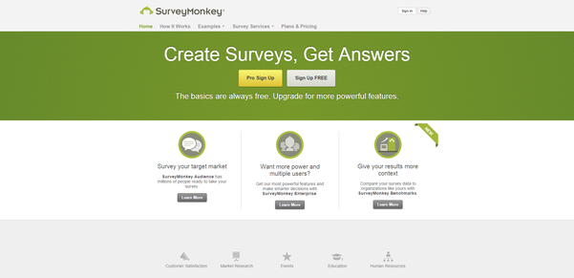
SURVEY MONKEY
Notes:
Survey Monkey is the largest online survey company. They can handle over one million responses every day on their rewritten Python.

Slide 12
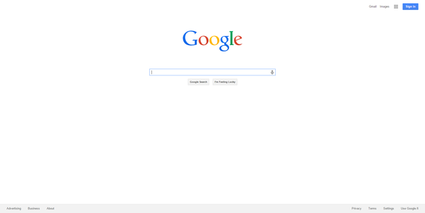
GOOGLE
Notes:
Python also provides the power behind the most popular search engine in the world – Google. The programming language can handle the traffic and computing needs of the search engine and its connected apps.

Slide 13
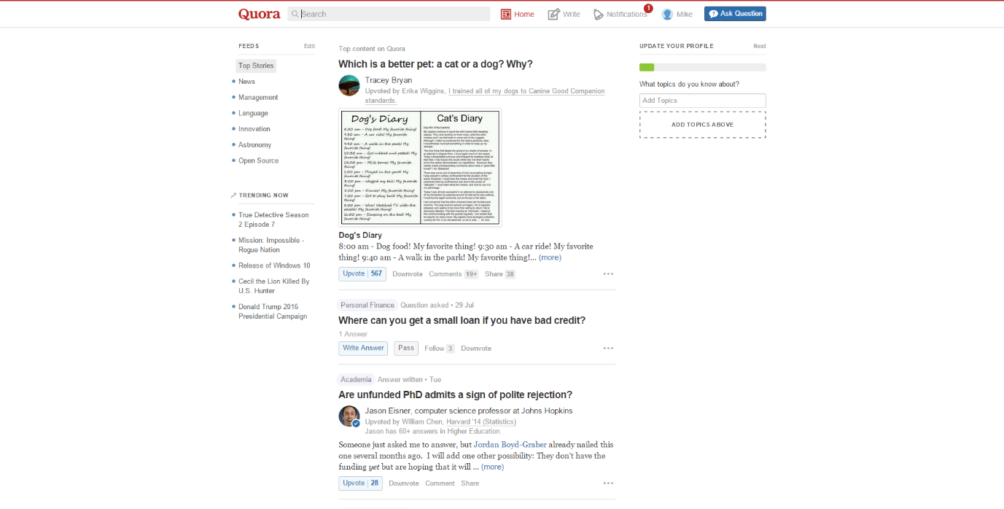
QUORA
Notes:
Quora is the number one place online to ask a question and receive answers from a community of individuals. On their Python website relevant results are answered, edited, and organized by these community members.

Slide 14
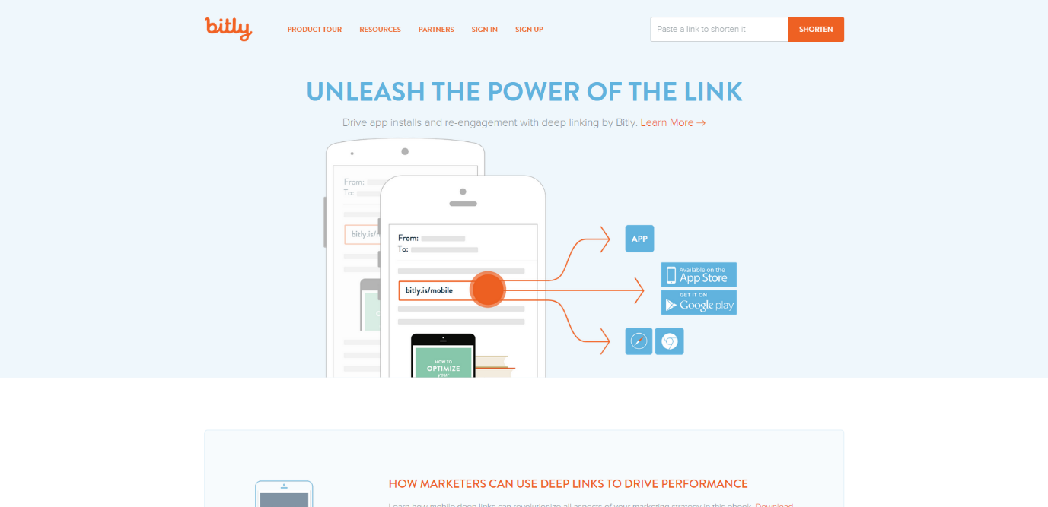
BITLY
Notes:
A majority of the code for Bitly URL shortening services and analytics are all built
with Python. Their service can handle hundreds of millions of events per day.

Slide 15
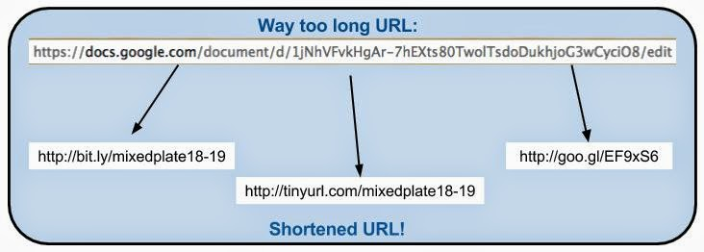

Slide 16
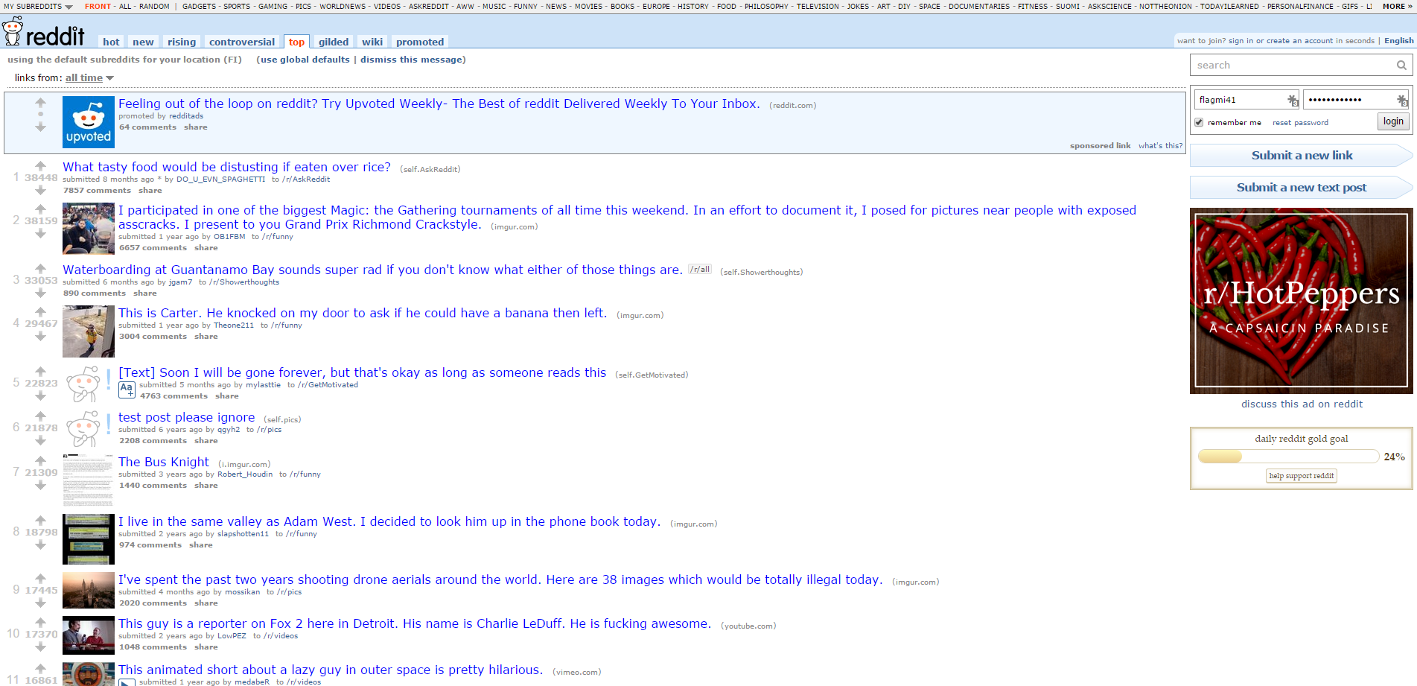
REDDIT
Notes:
Reddit is known as the front page of the internet. It is the place online to find information or entertainment based on thousands of different categories. Posts and links are user generated and are promoted to the top through votes. Many of Reddit’s capabilities rely on Python for their functionality.

Slide 17
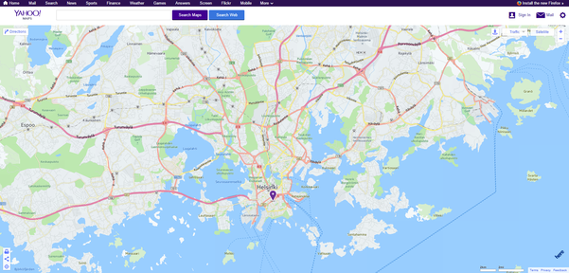
YAHOO MAPS
Notes:
Yahoo maps may be losing the battle to other map service providers, but it still holds some powerful tools. Yahoo’s map program runs on Python as well as many of its other programs.

Slide 18
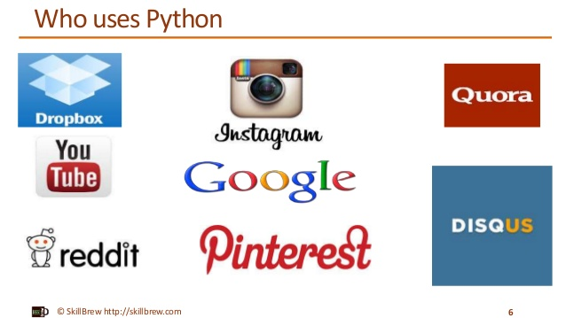
Your Future ….!!!

Slide 19
Let’s Find Out ….!!
Write a Program using any language you know to print “ HELLO WORLD “.

Slide 20
Python Is Easy to Use
C++ Program :
#include <iostream><br>
int main()
{
cout << "Hello World" << endl;
return 0;
}

Slide 21
C Program
#include <stdio.h>
int main(int argc, char ** argv)
{
printf(“Hello, World!\n”);
}

Slide 22
Java Program :
public class Hello
{
public static void main(String argv[])
{
System.out.println(“Hello, World!”);
}
}

Slide 23

Python Program :
print ( "Hello World")

Slide 24
The programming language Python was conceived in the A. 1955 B. 1981 C. 1989 D.1976

Slide 25
COMPARISON WITH JAVA
Python programs are typically 3-5 times shorter than equivalent Java programs.
Python programs are generally expected to run slower than Java programs.
Java, on the other hand, can perform an efficient integer or floating point addition, but requires variable declarations for a and b.

Slide 26
COMPARISON WITH C++
Python code is often 5-10 times shorter than equivalent C++ code.
Python uses algorithmic approach unlike C++.
Python is an interpretable language whereas C++ is a compiled language.

Slide 27
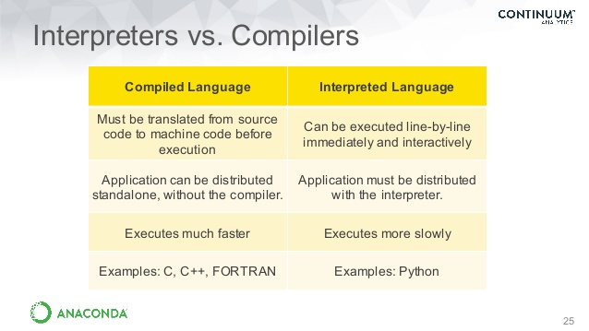

Slide 28
SALIENT FEATURES
Simple- Python is a simple language. Reading a good Python program feels almost like reading English. It allows you to concentrate on the solution to the problem rather than the syntax i.e. the language itself.
Easy to Learn-Python is extremely easy to get started with. Python has an extraordinarily simple syntax.

Slide 29
Open source : Python is publicly available open source software, any one can use source code that doesn't cost anything.
Portable : High level languages are portable, which means they are able to run across all major hardware and software platforms with few or no change in source code. Python is portable and can be used on Linux, Windows, Macintosh, Solaris, FreeBSD, OS/2, Amiga, AROS, AS/400 and many more.
Object-Oriented : Python is a full-featured object-oriented programming language, with features such as classes, inheritance, objects, and overloading.

Slide 30
Python is Interactive : Python has an interactive console where you get a Python prompt (command line) and interact with the interpreter directly to write and test your programs. This is useful for mathematical programming.
Interpreted : Python programs are interpreted, takes source code as input, and then compiles (to portable byte-code) each statement and executes it immediately. No need to compiling or linking

Slide 31
Extendable : Python is often referred to as a “glue” language, meaning that it is capable to work in mixed-language environment. The Python interpreter is easily extended and can add a new built-in function or modules written in C/C++/Java code.
Libraries : Databases, web services, networking, numerical packages, graphical user interfaces, 3D graphics, others.
Supports :Support from online Python community

Slide 32
VERSIONS OF PYTHON
Python 1.0 - January 1994
Python 1.5 - December 31, 1997
Python 1.6 - September 5, 2000
Python 2.0 - October 16, 2000
Python 2.1 - April 17, 2001
Python 2.2 - December 21, 2001
Python 2.3 - July 29, 2003
Python 2.4 - November 30, 2004
Python 2.5 - September 19, 2006
Python 2.6 - October 1, 2008
Python 2.7 - July 3, 2010

Slide 33
VERSIONS OF PYTHON
Python 3.0 - December 3, 2008
Python 3.1 - June 27, 2009
Python 3.2 - February 20, 2011
Python 3.3 - September 29, 2012
Python 3.4 - March 16, 2014
Python 3.5 - September 13, 2015

Slide 34
DOWNLOADING PYTHON
https://www.anaconda.com/products/individual

Slide 35
Python is
Compiled based language
Byte code Interpreted based language

Slide 36
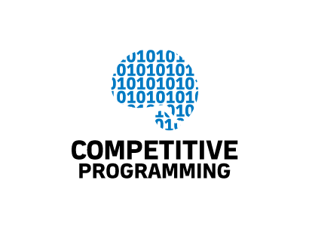
Competitive Programming is a sport. Its like Olympics of the programming.

Slide 38
Makes you a desirable candidate to major companies:Participation in the ACM International Collegiate Programming Contest (ACM ICPC) is a great opportunity to be seen by Apple, Facebook, Google, IBM and many other authorities in the IT sphere.
Makes you faster and more focused:In the competition, you must solve problems in stressful situations and do it up against a deadline or you will lose. Taking part in competitive programming teaches you how to be more focused on the task and not only complete it quickly, but accurately. These skills are highly beneficial for any job, not just in coding.

Slide 39






Companies
And many more……………

Slide 40
Challenges
ACM – ICPC
Google Code Jam
Topcoder Open
Google foo bar challenge
Facebook Hacker cup

Slide 41


